Slide 1
The Transport Layer (Basic Principles)
Computer Networks

Slide 2
The Transport Service
Services Provided to the Upper Layers
Transport Service Primitives
Berkeley Sockets
An Example of Socket Programming:
An Internet File Server

Slide 3
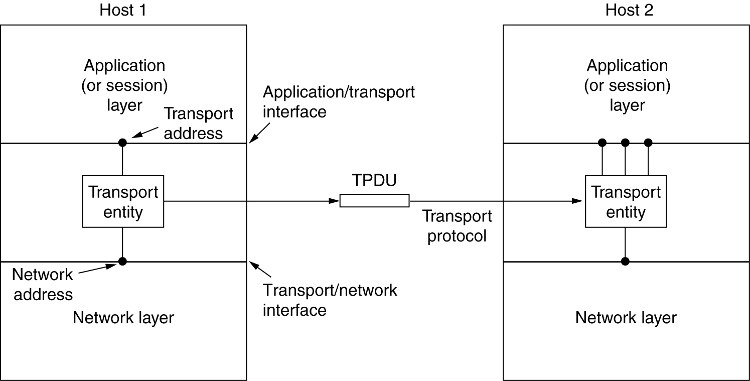
Services Provided to the Upper Layers
The network, transport, and application layers.

Slide 4
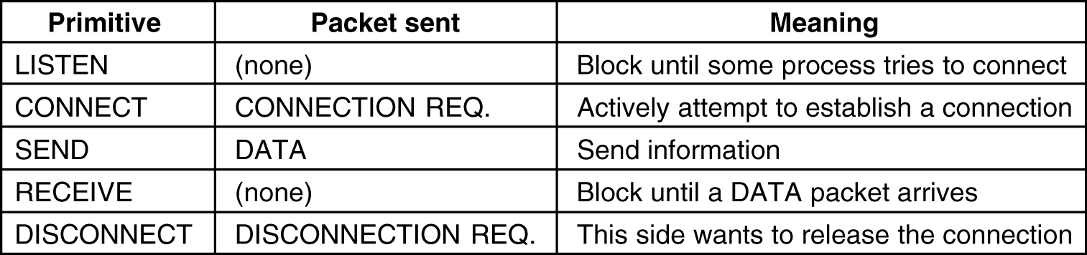
Transport Service Primitives
The primitives for a simple transport service.

Slide 5
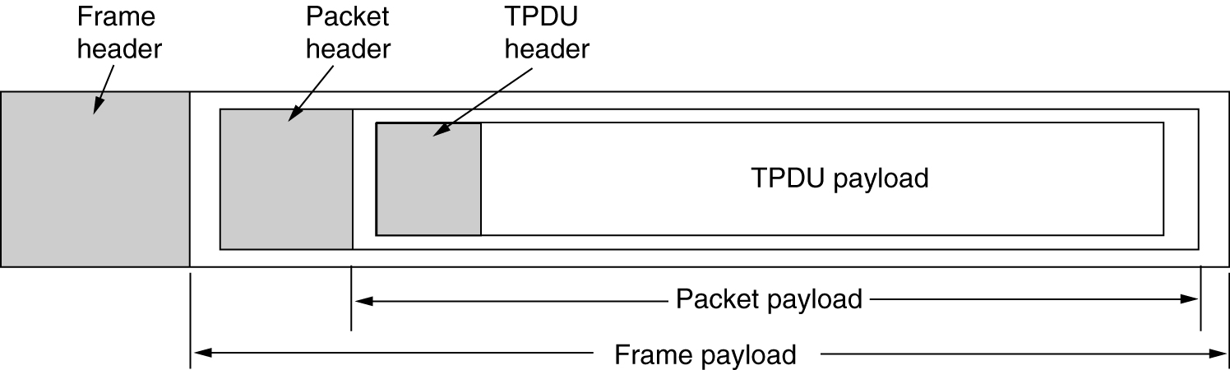
Transport Service Primitives (2)
The nesting of TPDUs, packets, and frames.

Slide 6
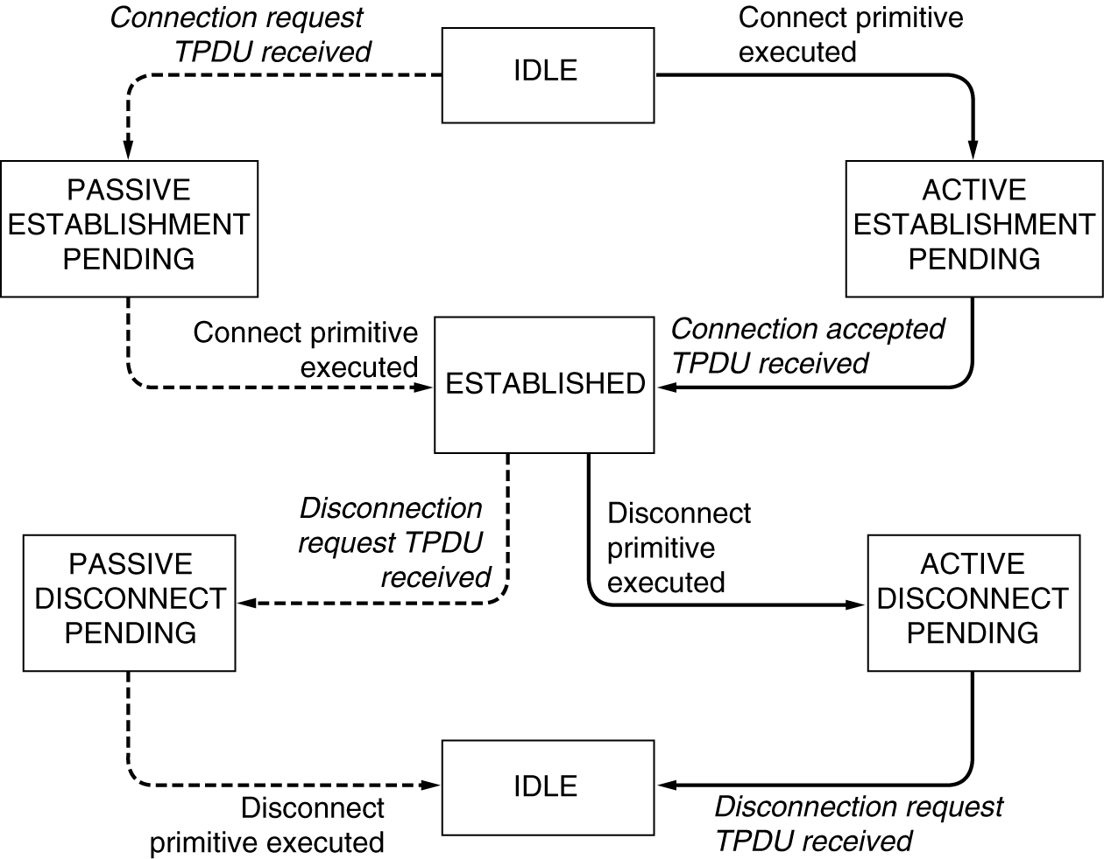
Transport Service Primitives (3)
A state diagram for a simple connection management scheme. Transitions labeled in italics are caused by packet arrivals. The solid lines show the client's state sequence. The dashed lines show the server's state sequence.

Slide 7
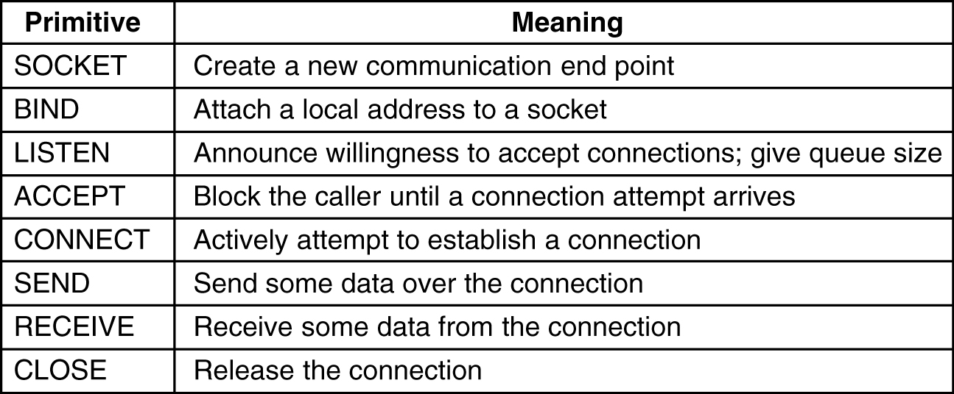
Berkeley Sockets
The socket primitives for TCP.

Slide 8
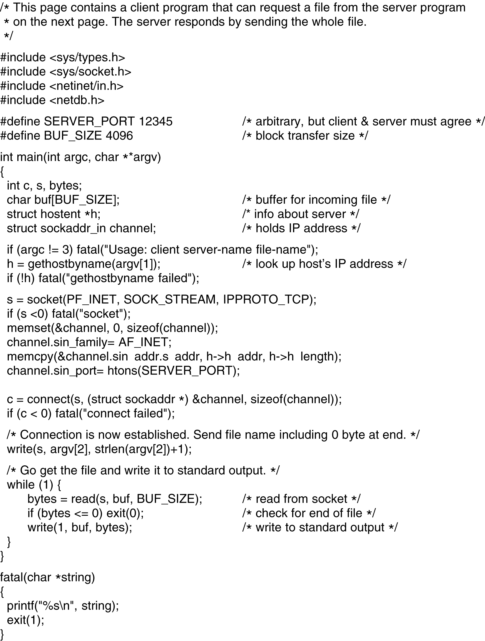
Socket Programming Example: Internet File Server
6-6-1
Client code using sockets.

Slide 9
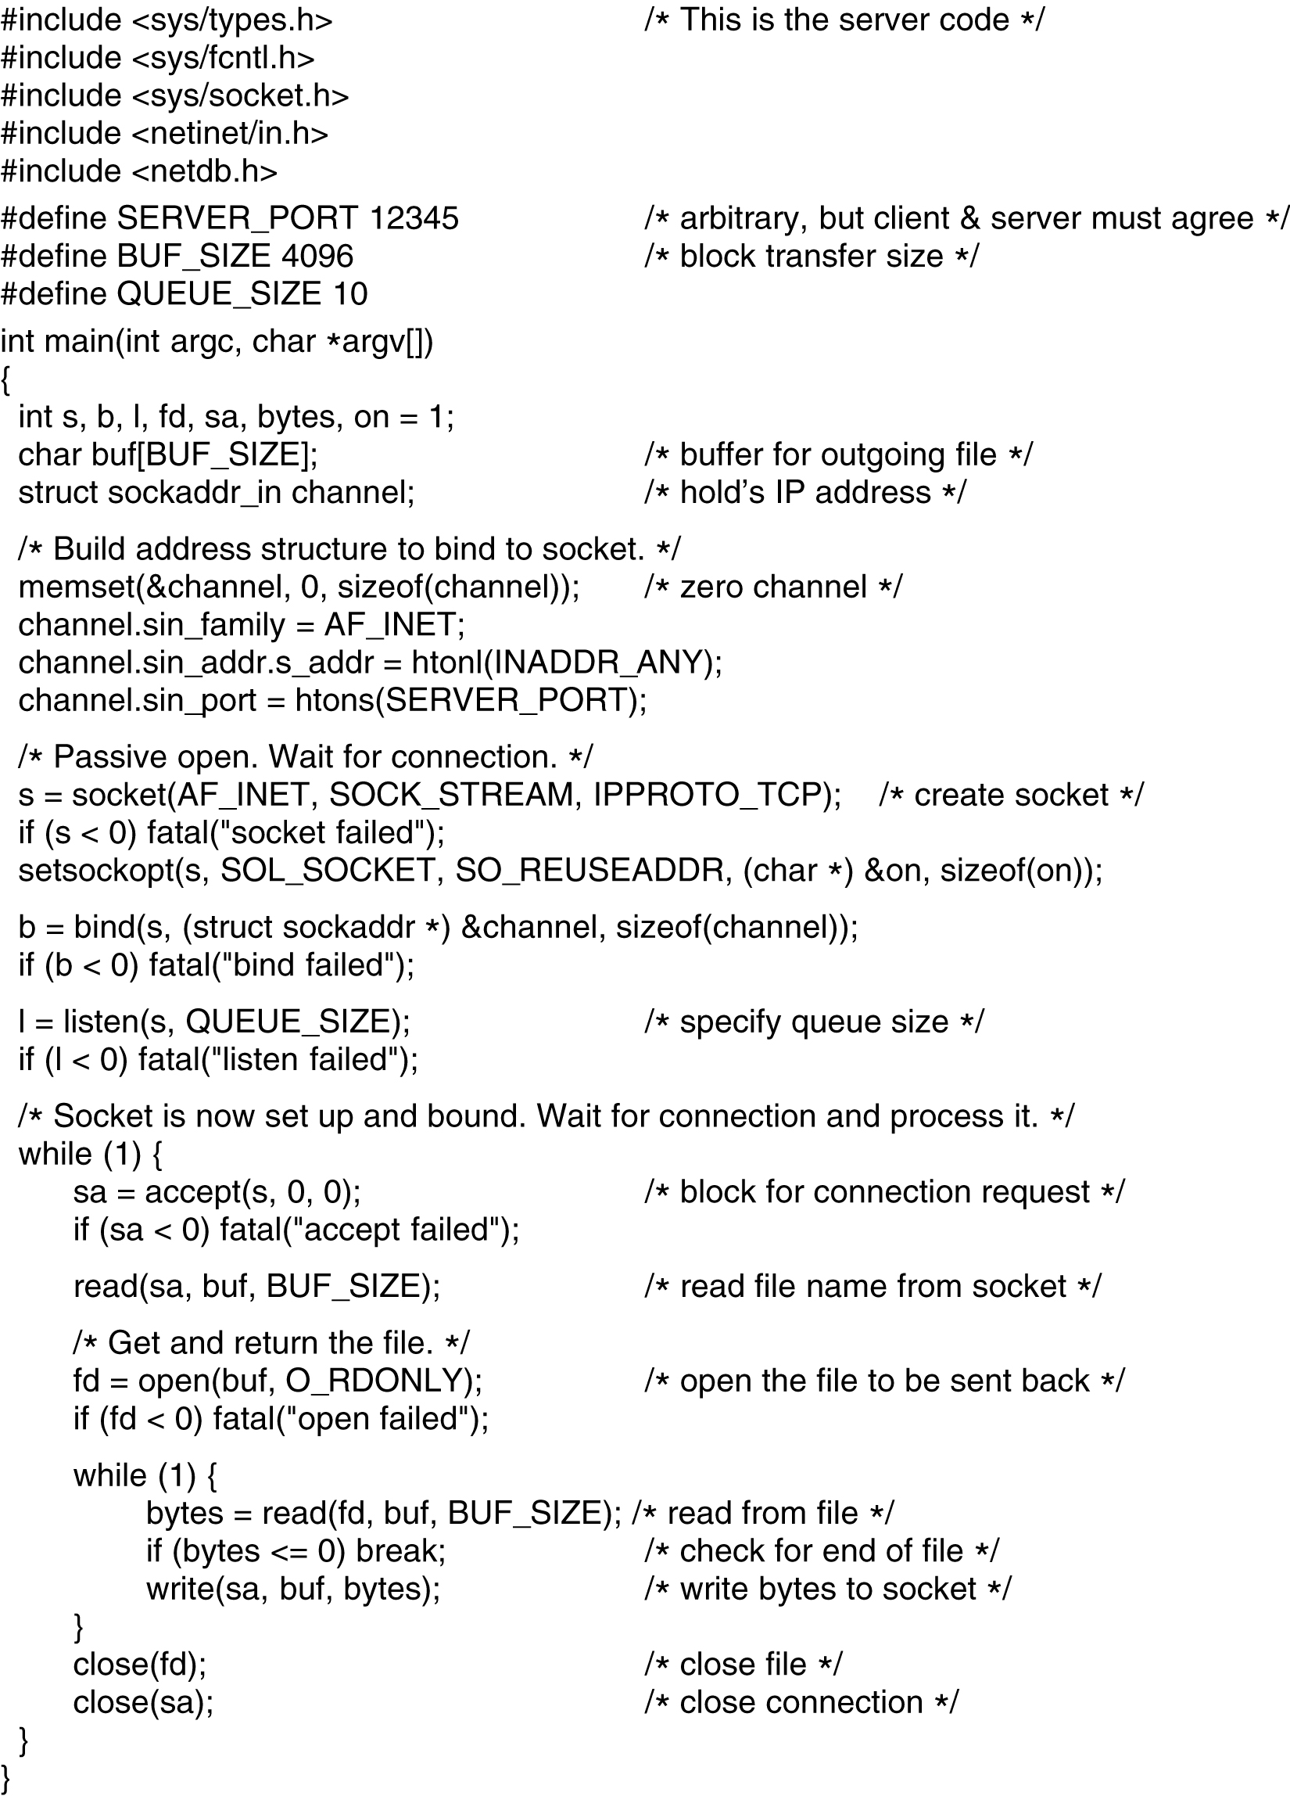
Socket Programming Example: Internet File Server (2)
Server code using sockets.

Slide 10
Elements of Transport Protocols
Addressing
Connection Establishment
Connection Release
Flow Control and Buffering
Multiplexing
Crash Recovery

Slide 11
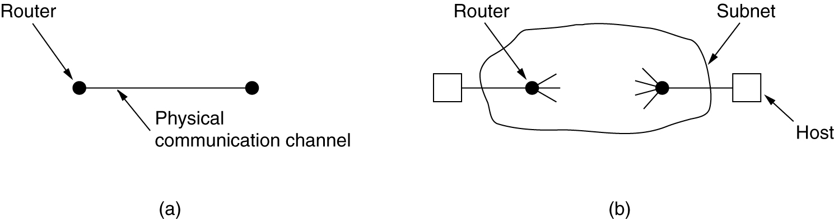
Transport Protocol
(a) Environment of the data link layer.
(b) Environment of the transport layer.

Slide 12
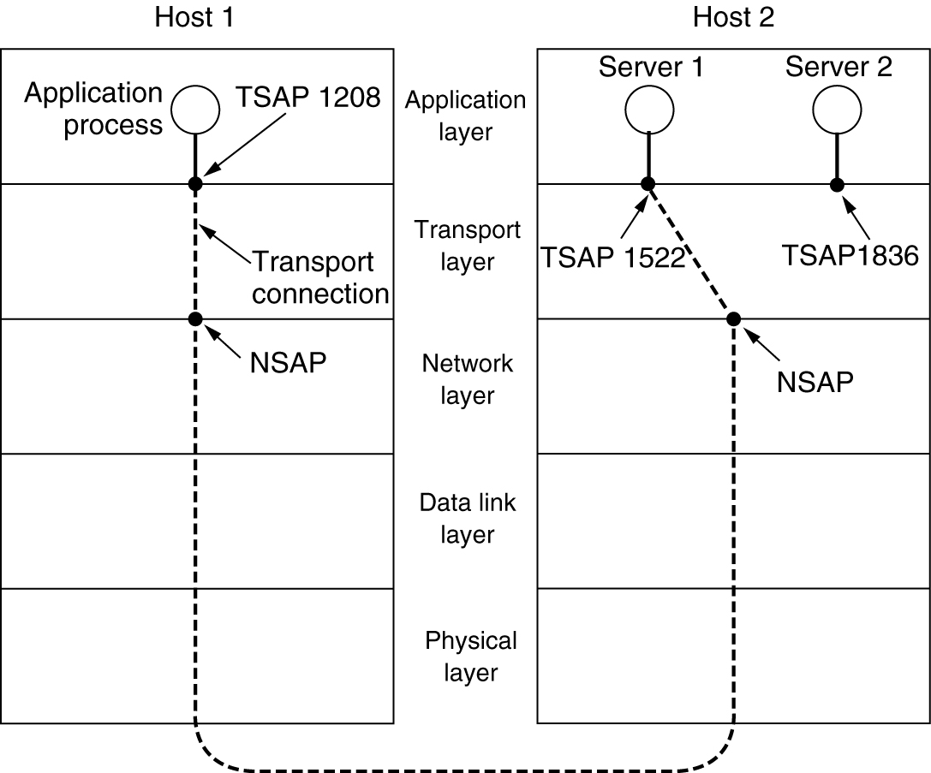
Addressing
TSAPs, NSAPs and transport connections.

Slide 13
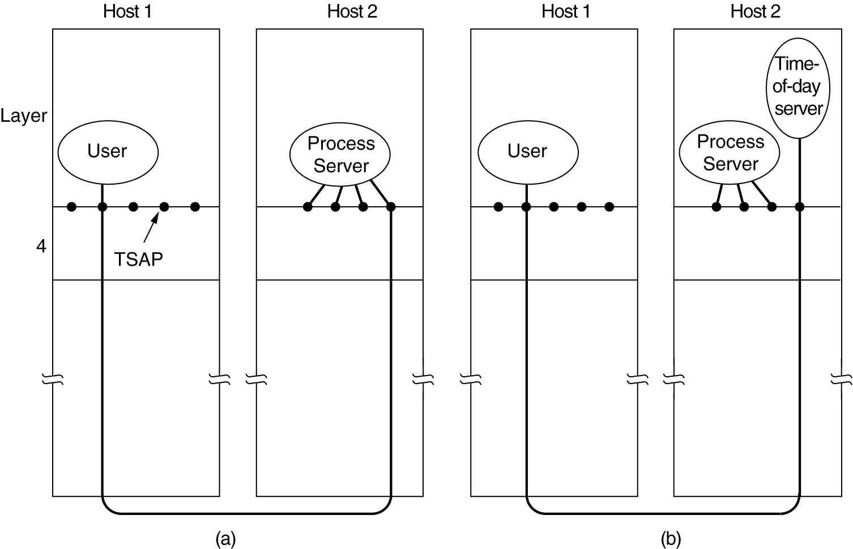
Connection Establishment
How a user process in host 1 establishes a connection with a time-of-day server in host 2.

Slide 14
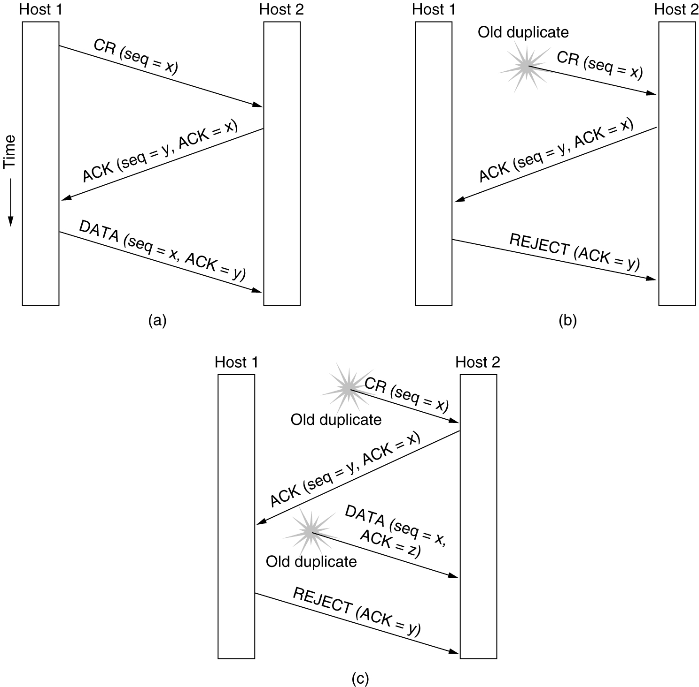
Connection Establishment (cont.)
Three protocol scenarios for establishing a connection using a three-way handshake. CR denotes CONNECTION REQUEST. (a) Normal operation, (b) Old CONNECTION REQUEST appearing out of nowhere. (c) Duplicate CONNECTION REQUEST and duplicate ACK.

Slide 15
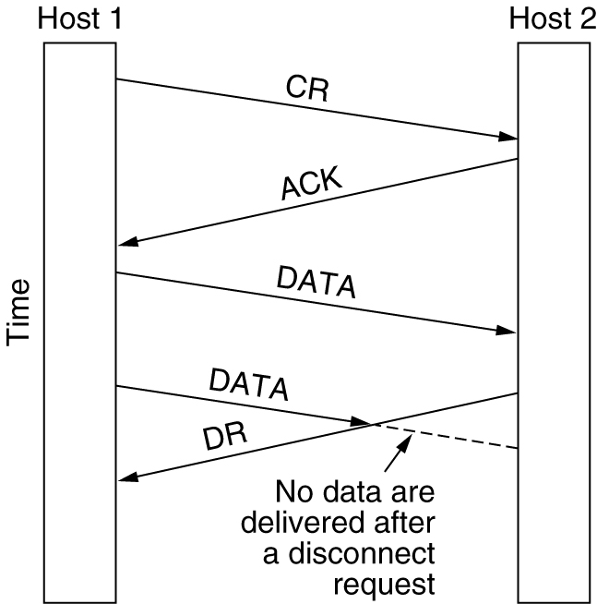
Connection Release
Abrupt disconnection with loss of data.

Slide 16
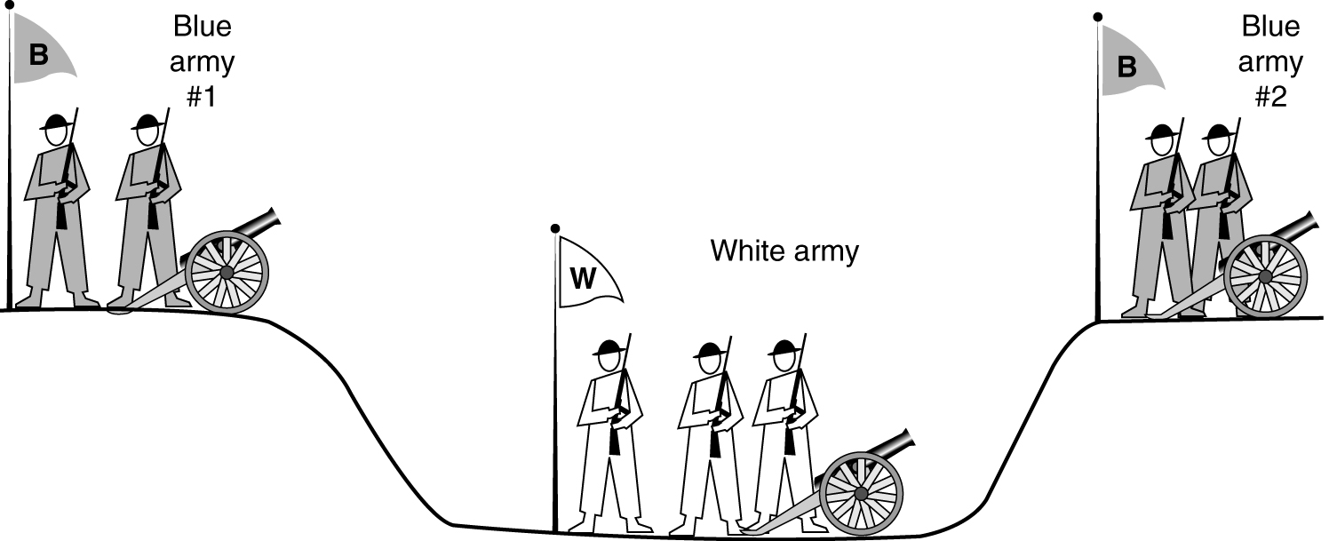
Connection Release (2)
The two-army problem.

Slide 17
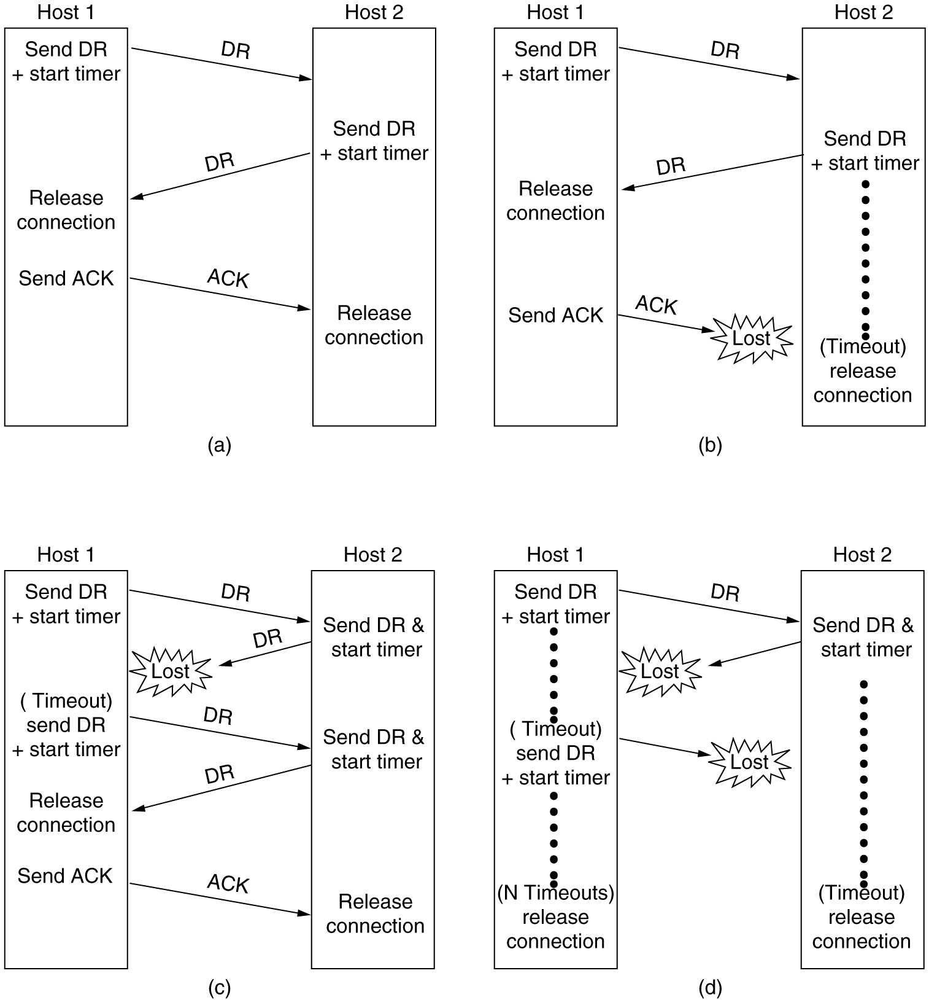
Connection Release (3)
6-14, a, b
Four protocol scenarios for releasing a connection. (a) Normal case of a three-way handshake. (b) final ACK lost.

Slide 18
Connection Release (4)
6-14, c,d
(c) Response lost. (d) Response lost and subsequent DRs lost.

Slide 19
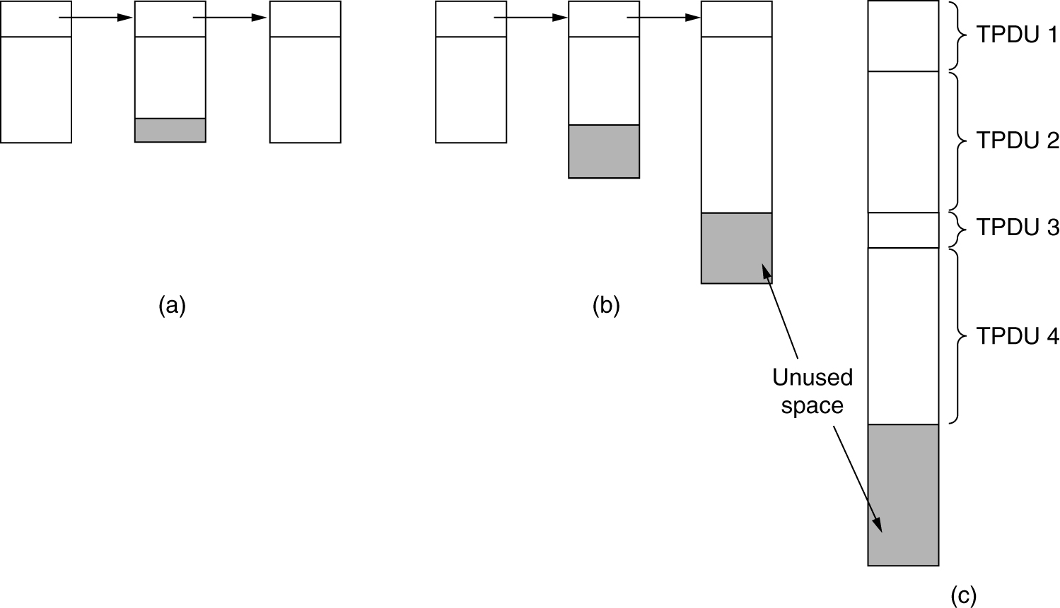
Flow Control and Buffering
(a) Chained fixed-size buffers. (b) Chained variable-sized buffers. (c) One large circular buffer per connection.

Slide 20
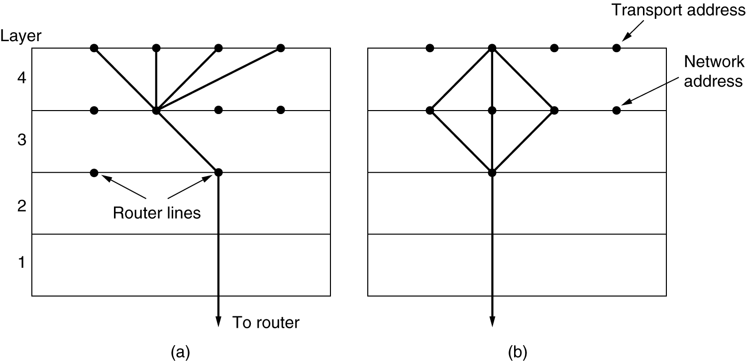
Multiplexing
(a) Upward multiplexing. (b) Downward multiplexing.

Slide 21
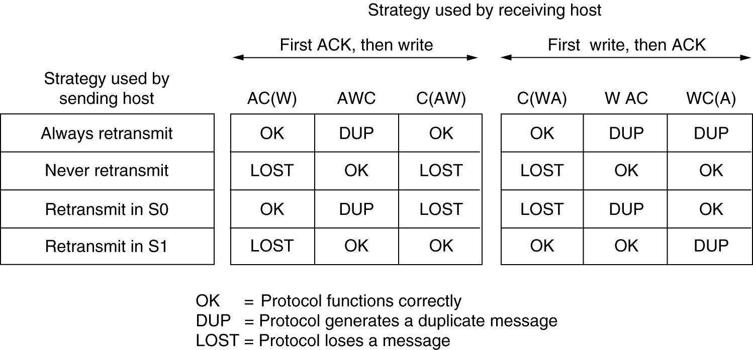
Crash Recovery
Different combinations of client and server strategy.

Slide 22
A Simple Transport Protocol
The Example Service Primitives
The Example Transport Entity
The Example as a Finite State Machine

Slide 23
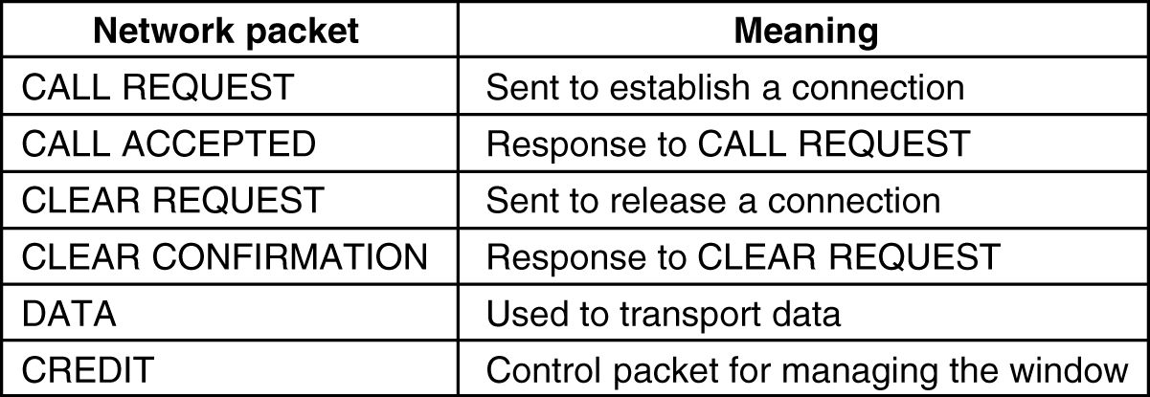
The Example Transport Entity
The network layer packets used in our example.

Slide 24
The Example Transport Entity (2)
Each connection is in one of seven states:
Idle – Connection not established yet.
Waiting – CONNECT has been executed, CALL REQUEST sent.
Queued – A CALL REQUEST has arrived; no LISTEN yet.
Established – The connection has been established.
Sending – The user is waiting for permission to send a packet.
Receiving – A RECEIVE has been done.
DISCONNECTING – a DISCONNECT has been done locally.

Slide 25
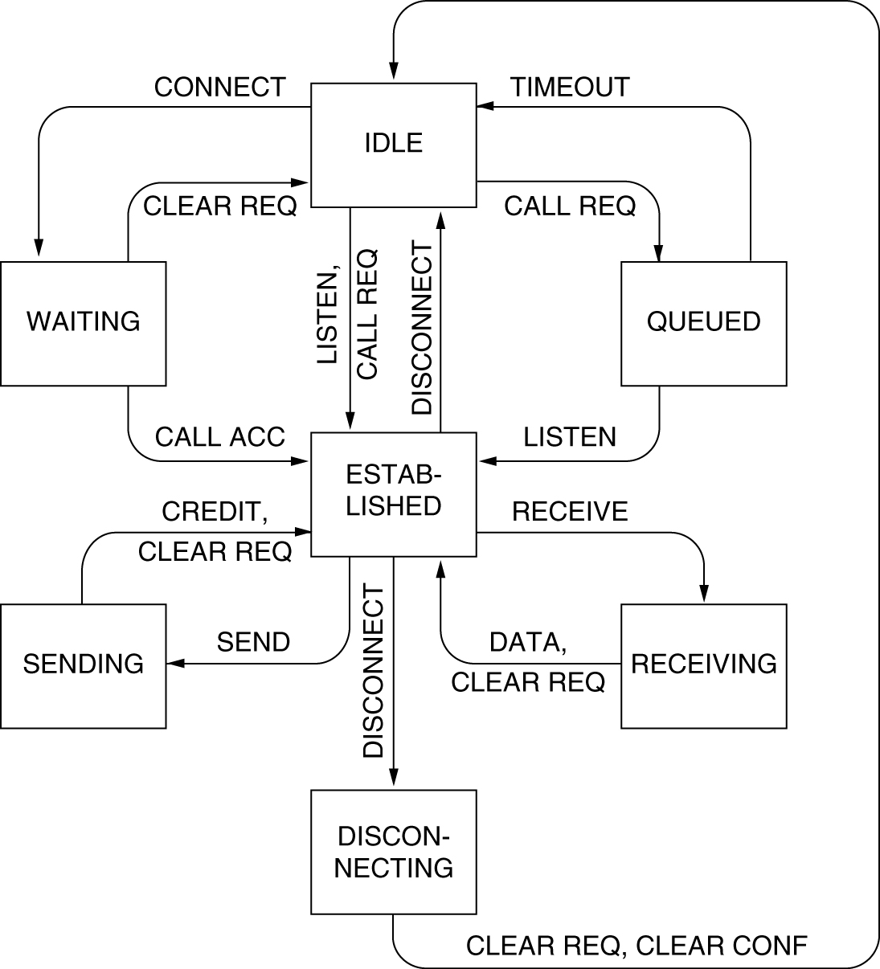
The Example as a Finite State Machine (2)
The example protocol in graphical form. Transitions that leave the connection state unchanged have been omitted for simplicity.

Slide 26
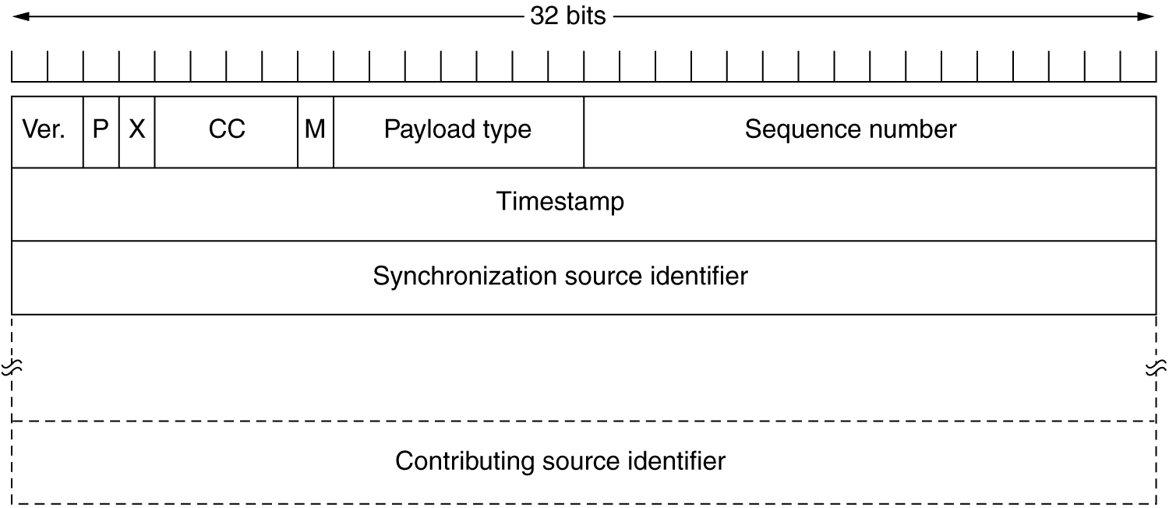
The Real-Time Transport Protocol (2)
The RTP header.

Slide 27
Performance Issues
Performance Problems in Computer Networks
Network Performance Measurement
System Design for Better Performance
Fast TPDU Processing
Protocols for Gigabit Networks

Slide 28
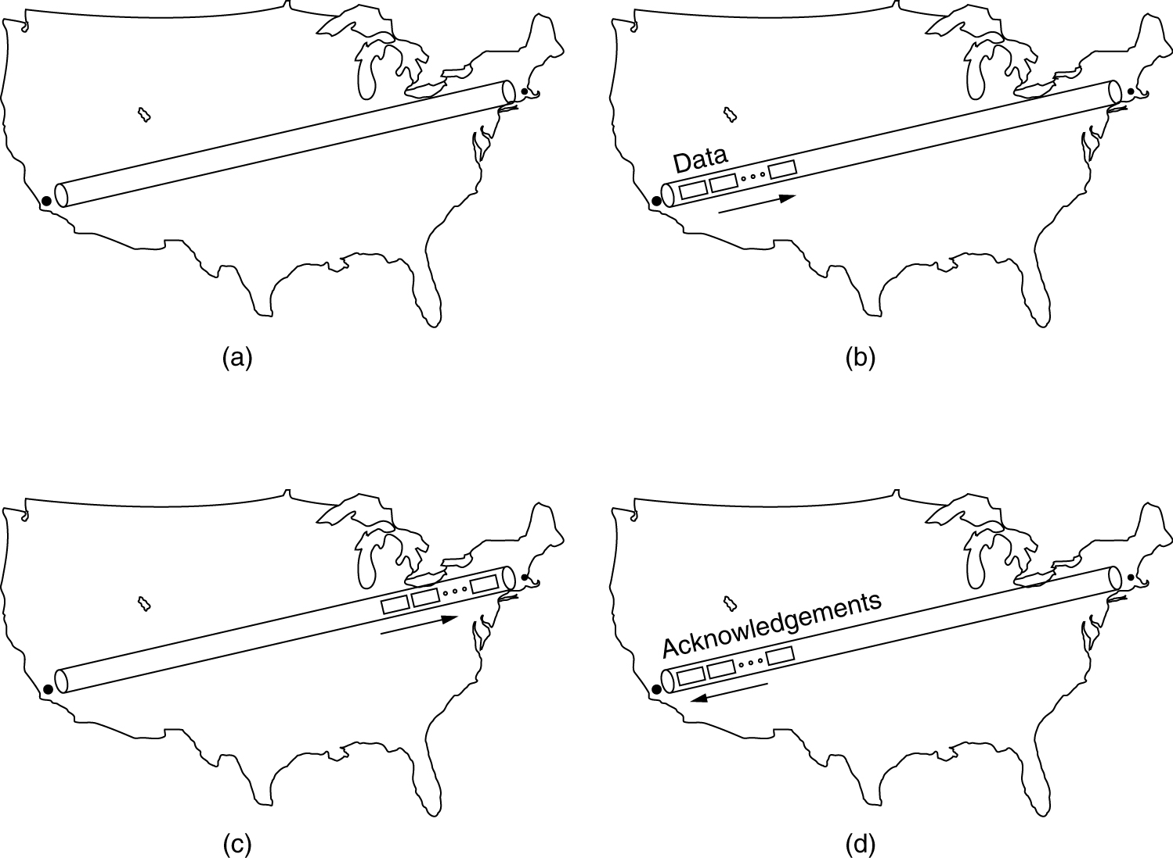
Performance Problems in Computer Networks
The state of transmitting one megabit from San Diego to Boston
(a) At t = 0, (b) After 500 μsec, (c) After 20 msec, (d) after 40 msec.

Slide 29
Network Performance Measurement
The basic loop for improving network performance.
Measure relevant network parameters, performance.
Try to understand what is going on.
Change one parameter.

Slide 30
System Design for Better Performance
Rules:
CPU speed is more important than network speed.
Reduce packet count to reduce software overhead.
Minimize context switches.
Minimize copying.
You can buy more bandwidth but not lower delay.
Avoiding congestion is better than recovering from it.
Avoid timeouts.

